Slide 1
Functions, Pigeonhole Principle
f( ) =
A
B

Slide 2
This Lecture
We will define what is a function “formally”, and then
in the next lecture we will use this concept in counting.
We will also study the pigeonhole principle and its applications.
Examples and definitions (injection, surjection, bijection)
Pigeonhole principle and applications

Slide 3
Functions
Informally, we are given an “input set”,
and a function gives us an output for each possible input.
input
function
output
The important point is that there is only one output for each input.
We say a function f “maps” the element of an input set A
to the elements of an output set B.

Slide 4
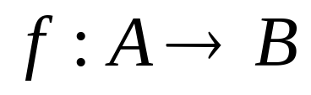


Functions
More formally, we write
to represent that f is a function from set A to set B, which
associates an element with an element
The domain (input) of f is A.
The codomain (output) of f is B.
Definition: For every input there is exactly one output.
Note: the input set can be the same as the output set, e.g. both are integers.

Slide 5
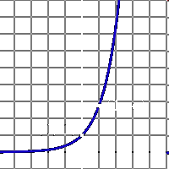

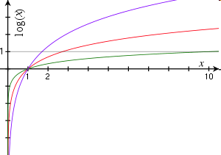

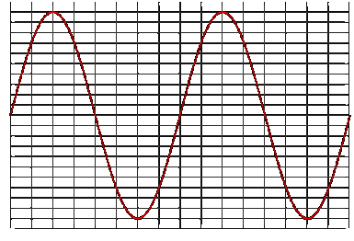


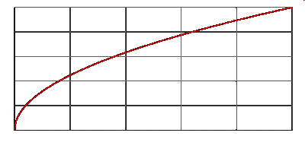
Examples of Functions
domain = R
codomain = R^{>0}
domain = R^{>0}
codomain = R
domain = R
codomain = [-1,1]
domain = R^{>=0}
codomain = R^{>=0}

Slide 6
Examples of Functions
f(S) = |S|
domain = the set of all finite sets
codomain = non-negative integers
domain = the set of all finite strings
codomain = non-negative integers
f(string) = length(string)
not a function,
since one input could have
more than one output
f(student-name) = student-ID
f(x) = is-prime(x)
domain = positive integers
codomain = {T,F}

Slide 7

Injections
is an injection if no two inputs have the same output.
f( ) =
≤ 1 arrow in
A
B
|A| ≤ |B|

Slide 8
Surjections
is a surjection if every output is possible.
f( ) =
1 arrow in
A
B
|A| ≥ |B|

Slide 9
Bijections
is a bijection if it is surjection and injection.
exactly one arrow in
f( ) =
A
B
|A| = |B|

Slide 10
Exercises
Function | Domain | Codomain | Injective? | Surjective? | Bijective?
f(x)=sin(x) | Real | Real
f(x)=2^{x} | Real | Positive real
f(x)=x² | Real | Non-negative real
Reverse string | Bit strings of length n | Bit strings of length n
Whether a function is injective, surjective, bijective
depends on its domain (i.e. input) and the codomain (i.e. output).

Slide 11
Inverse Sets
A
B
Given an element y in B, the inverse set of y := f⁻¹(y) = {x in A | f(x) = y}.
In words, this is the set of inputs that are mapped to y.
More generally, for a subset Y of B,
the inverse set of Y := f⁻¹(Y) = {x in A | f(x) in Y}.

Slide 12
Inverse Function
Informally, an inverse function f⁻¹ is to “undo” the operation of function f.
exactly one arrow in
f( ) =
A
B
There is an inverse function f⁻¹ for f if and only if f is a bijection.

Slide 13
Composition of Functions
Two functions f:X->Y’, g:Y->Z so that Y’ is a subset of Y,
then the composition of f and g is the function g。f: X->Z, where
g。f(x) = g(f(x)).
f
Y’
g
X
Z
Y

Slide 14
Exercises
Function f | Function g | g。f injective? | g。f surjective? | g。f bijective?
f:X->Y f surjective | g:Y->Z g injective
f:X->Y f surjective | g:Y->Z g surjective
f:X->Y f injective | g:Y->Z g surjective
f:X->Y f bijective | g:Y->Z g bijective
f:X->Y | f⁻¹:Y->X

Slide 15
This Lecture
Examples and definitions (injection, surjection, bijection)
Pigeonhole principle and applications

Slide 16

Pigeonhole Principle
If more pigeons
than pigeonholes,

Slide 17
Pigeonhole Principle
then some hole must have at least two pigeons!
Pigeonhole principle
A function from a larger set to a smaller set cannot be injective.
(There must be at least two elements in the domain that are
mapped to the same element in the codomain.)

Slide 18
Example 1
Question: Let A = {1,2,3,4,5,6,7,8}
If five distinct integers are selected from A,
must a pair of integers have a sum of 9?
Consider the pairs {1,8}, {2,7}, {3,6}, {4,5}.
The sum of each pair is equal to 9.
If we choose 5 numbers from the set A,
then by the pigeonhole principle,
both elements of some pair will be chosen,
and their sum is equal to 9.

Slide 19
Example 2
Question: In a party of n people, is it always true that there are
two people shaking hands with the same number of people?
Everyone can shake hand with 0 to n-1 people, and there are n people,
and so it does not seem that it must be the case, but think about it carefully:
Case 1: if there is a person who does not shake hand with others,
then any person can shake hands with at most n-2 people,
and so everyone shakes hand with 0 to n-2 people, and so
the answer is “yes” by the pigeonhole principle.
Case 2: if everyone shakes hand with at least one person, then
any person shakes hand with 1 to n-1 people, and so
the answer is “yes” by the pigeonhole principle.

Slide 20
Birthday Paradox
In a group of 367 people, there must be two people having the same birthday.
Suppose n <= 365, what is the probability that in a random set of n people,
some pair of them will have the same birthday?
We can think of it as picking n random numbers from 1 to 365 without repetition.
There are 365^{n} ways of picking n numbers from 1 to 365.
There are 365·364·363·…·(365-n+1) ways of
picking n numbers from 1 to 365 without repetition.
So the probability that no pairs have the same birthday is
equal to 365·364·363·…·(365-n+1) / 365^{n}
This is smaller than 50% for 23 people, smaller than 1% for 57 people.

Slide 21
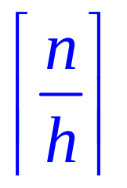
Generalized Pigeonhole Principle
Generalized Pigeonhole Principle
If n pigeons and h holes,
then some hole has at least
pigeons.
♠ ♥ ♣ ♦
Cannot have < 3 cards in every hole.

Slide 22
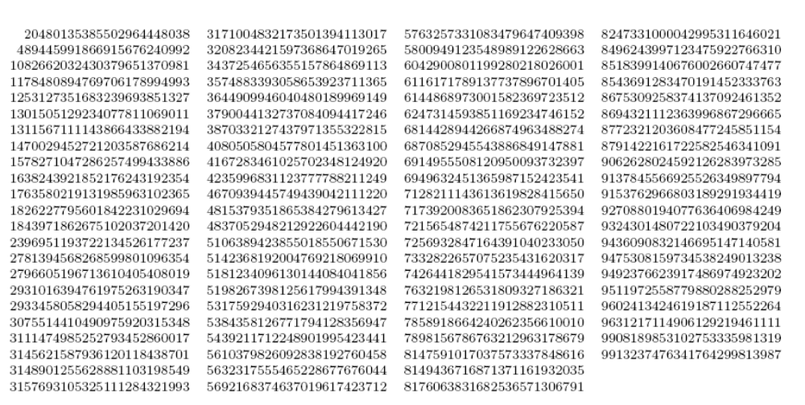
Subset Sum
Two different subsets of the 90 25-digit numbers shown above have the same sum.

Slide 23
Subset Sum
We are asking whether two subsets must have the same sum.
We can ask whether the opposite can hold: whether all subsets have different sums.
We will show that it is not possible for all subsets to have different sums.
The strategy is by counting.
We will count how many possible different subsets are there, say the answer is X.
And we will also count how many possible different sums are there, say the ans is Y.
If X > Y, then by the pigeonhole principle, there are more inputs than outputs and
thus it is not possible for all subsets to have different sums.
Input:
subsets
Output:
sums
function:
sum

Slide 24
Subset Sum
Let A be the set of the 90 numbers, each with at most 25 digits.
So the total sum of the 90 numbers is at most 90x10²⁵.
Let X be the set of all subsets of the 90 numbers.
(pigeons)
Let Y be the set of integers from 0 to 90x10²⁵.
(pigeonholes)
Let f:X->Y be a function mapping each subset of A into its sum.
If we could show that |X| > |Y|, then by the pigeonhole principle,
the function f must map two elements in X into the same element in Y.
This means that there are two subsets with the same sum.

Slide 25
Subset Sum
90 numbers, each with at most 25 digits.
So the total sum of the 90 numbers is at most 90x10²⁵
Let X be the set of all subsets of the 90 numbers.
(pigeons)
Let Y be the set of integers from 0 to 90x10²⁵.
(pigeonholes)
So, |X| > |Y|.
By the pigeonhole principle, there are two different subsets with the same sum.

Slide 26
Club vs Strangers
Let’s agree that given any two people, either they have met or not.
If every people in a group has met, then we’ll call the group a club.
If every people in a group has not met, then we’ll call a group of strangers.
Theorem: Every collection of 6 people includes a club of 3 people,
or a group of 3 strangers.
Let x be one of the six people.
By the (generalized) pigeonhole principle, we have the following claim.
Claim: Among the remaining 5 people, either 3 of them have met x,
or 3 of them have not met x.

Slide 27
Club vs Strangers
Theorem: Every collection of 6 people includes a club of 3 people,
or a group of 3 strangers.
Claim: Among the remaining 5 people, either 3 of them have met x,
or 3 of them have not met x.
Case 1: “3 people have met x”
Case 1.1: No pair among those people met each other.
Then there is a group of 3 strangers.
OK!
Case 1.2: Some pair among those people have met each other.
Then that pair, together with x, form a club of 3 people.
OK!

Slide 28
Club vs Strangers
Theorem: Every collection of 6 people includes a club of 3 people,
or a group of 3 strangers.
Claim: Among the remaining 5 people, either 3 of them have met x,
or 3 of them have not met x.
Case 2: “3 people have not met x”
Case 2.1: Every pair among those people met each other.
Then there is a club of 3 people.
OK!
OK!
Case 2.2: Some pair among those people have not met each other.
Then that pair, together with x, form a group of 3 strangers.

Slide 29
Club vs Strangers
Theorem: Every collection of 6 people includes a club of 3 people,
or a group of 3 strangers.
Theorem: For every k, if there are enough people,
then either there exists a club of k people,
or a group of k strangers.
A large enough structure cannot be totally disorder.
This is a basic result of Ramsey theory.

Slide 30
Quick Summary
Make sure you understand basic definitions of functions.
These will be used in the next lecture for counting.
The pigeonhole principle is very simple,
but there are many clever uses of it to prove non-trivial results.

Slide 31
Mapping Between Infinite Sets (Optional)
How to compare the size of two infinite sets?
Cantor proposed an elegant defintion:
Two infinite sets are “equal” if there is a bijection between them.
Using this definition, it can be shown that:
The set of positive integers = the set of integers
The set of integers = the set of rational numbers
The set of integers ≠ the set of real numbers

